Slide 1
Reinforcement Learning for Long-Term Stock Market Asset Rotation
Choosing stocks within the S&P 500 using Fundamental Features and Liquidity Constraints
Presenter: Barak Barclay

Slide 2
Introduction and Stock Constraints
Problem: Traditional algorithmic trading prioritizes high-frequency noise over operational quality.
Vision: Using RL to identify long-term value through "Fundamental Features/Metrics".
Stock Constraints:
S&P 500 businesses.
The Double Blacklist (Stretch Goal):
Sin Stocks: No gambling, tobacco, or addictive substance sectors.
Debt-Profiteers: No banks or financial conglomerates (including Berkshire Hathaway).

Slide 3
Data and Feature Engineering
The 14 Features: Each stock is analyzed via 7 metrics + their growth rates:
Earnings/Income: EPS and Net Income.
Efficiency/Scale: ROE and Market Cap.
Health/Safety: Net Cash and Free Cash Flow.
Value: PEG Ratio.
Imputation Strategy: "NaN" data (e.g., PEG for negative earnings) mapped to a penalty value.
Normalization: Growth metrics will be transformed using symmetric log-scaling for numerical stability.
State Space Normalization: Z-score and Symmetric Log-Scaling used to stabilize Deep RL function approximation.
Notes:
Normalization: Growth metrics in the stock market can be extremely volatile; one company might have 5% growth while another has 5,000%. If you feed these raw numbers into a Reinforcement Learning agent, the massive outliers will "overwhelm" the smaller, more common values, leading to training instability. Symmetric log-scaling is a transformation that "squashes" large numbers while preserving their direction (positive or negative) and their scale near zero.
State Space Normalization: Deep Reinforcement Learning (RL) agents struggle when inputs have vastly different scales—for example, a Market Cap in the trillions versus a PEG Ratio near 1.0. Normalization ensures these values are on a similar "playing field" for the function approximation process.

Slide 4
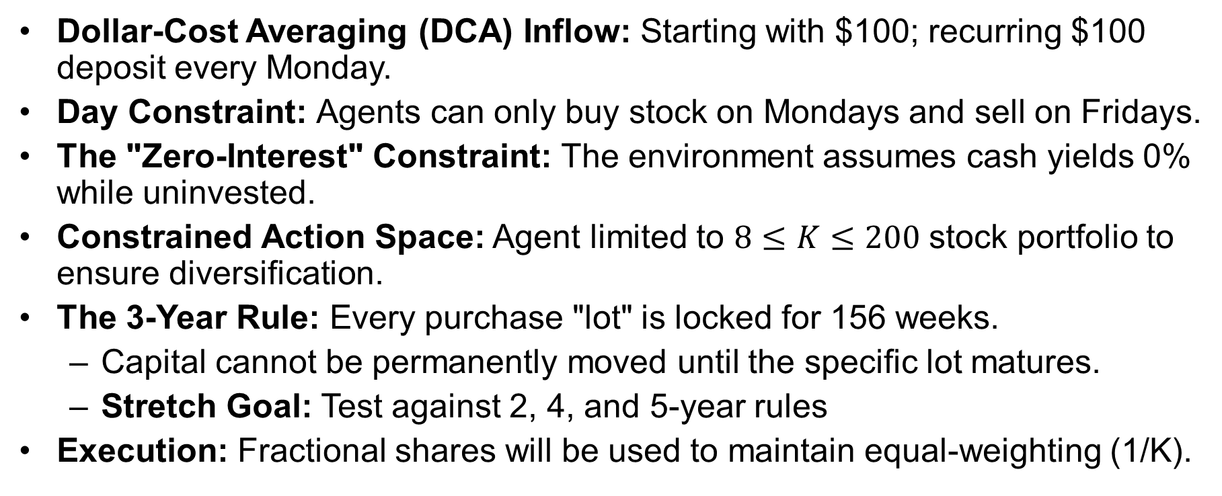
Capital and Temporal Constraints
Dollar-Cost Averaging (DCA) Inflow: Starting with $100; recurring $100 deposit every Monday.
Day Constraint: Agents can only buy stock on Mondays and sell on Fridays.
The "Zero-Interest" Constraint: The environment assumes cash yields 0% while uninvested.
Constrained Action Space: Agent limited to $8≤K≤200$ stock portfolio to ensure diversification.
The 3-Year Rule: Every purchase "lot" is locked for 156 weeks.
Capital cannot be permanently moved until the specific lot matures.
Stretch Goal: Test against 2, 4, and 5-year rules
Execution: Fractional shares will be used to maintain equal-weighting (1/K).
Notes:
Dollar-Cost Averaging is an investment strategy where a fixed dollar amount is invested on a regular schedule, regardless of the asset's price.
Time Constraint: I will either introduce a time constraint or use the average for the day
The 3-Year Rule: Most RL agents "over-trade" to chase small gains. By forcing a 3-year lock-up, I am mathematically forcing the agent to prioritize companies with "Durable Competitive Advantages" (High ROE and Low Debt) over temporary price spikes.

Slide 5
Temporal Agent Architecture
Mixture of Agents: Five parallel agents trained on 1y, 2y, 3y, 5y, and 10y windows.
Agent Autonomy: Each agent learns to weigh metrics differently based on their specific historical horizon.
Optional Weekend Cycle (Stretch Goal): Agents may choose to sell on Friday and rebuy the following Monday; this would not reset 3-year maturity timer.
Stretch Goal: Allow the agent to account for other long-term patterns in the stock market

Slide 6
The RL Framework and Policy Development
The Markov Decision Process (MDP) Foundation:
State (S): The 14 fundamental features (EPS, ROE, Net Cash, etc.).
Action (A): A Ranking-Based Policy using a Softmax layer to select the Top-K active set (8 to 200 stocks).
Reward (R): Total Profit and Internal Rate of Return (IRR), utilizing Reward Shaping via penalty imputation for negative earnings/missing data.
Deep RL & Function Approximation:
Utilizing Deep Neural Networks to map high-dimensional fundamental states to preference rankings (Non-linear Function Approximation).
Experience Replay (ER):
Agents sample from diverse historical market "regimes" to maintain policy stability and prevent "forgetting" past volatility.
Notes:
The Ranking-Based Policy: Instead of the agent outputting a probability for every possible combination of 8 to 200 stocks (which would be a mathematically impossible number of combinations), it assigns a preference score to every individual stock in the S&P 500.
The Softmax layer is a mathematical function that takes those raw preference scores and turns them into a probability distribution that sums to 1.
Internal Rate of Return (IRR) is a financial metric used to estimate the profitability of potential investments.
High-Dimensional Fundamental States: In my project, the State Space is not just a single number; it is a "high-dimensional" collection of data points.
Non-linear Function Approximation: Neural networks use "activation functions" that allow the agent to understand complex, non-obvious relationships—for example, a high ROE might be good, but only if the Debt-to-Equity ratio is below a certain threshold.

Slide 7
Evaluation Framework
Primary Metric: Total Profit and Internal Rate of Return (IRR).
IRR is critical for accounting for the periodic $100 cash inflows.
Goal-Conditioned Analysis (Stretch Goal): Comparing agent behavior across other profiles:
Max Wealth over a period of time
Fastest reach a goal (e.g. $100,000)

Slide 8
The Agent Decision Process (Step-by-Step)
Step 1: Metric Weighting
Each agent determines its own internal ranking based on the 14 fundamental features.
Step 2: Selection Thresholding
The agent chooses an "Active Set" of stocks that pass its learned quality thresholds for that specific market week.
Step 3: Cardinality Balancing
The agent ensures the Active Set contains between 8 and 200 stocks to satisfy the project's diversification constraint for the total portfolio.
Step 4: Equal-Weight Deployment
The incoming $100 is split exactly 1/K into fractional shares of the chosen Active Set.
Step 5: Lot Management
The purchase date for this new lot is recorded to begin a 156-week maturity countdown.

Slide 9
Stretch Goal: The Meta-Learner
Concept: An Actor-Critic agent acting as a "Manager“ or "Meta-Learner".
The Actor (Policy): Dynamically weighs the advice of the five agents (1y, 2y, 3y, 5y, 10y) based on current environmental feedback.
The Critic (Value Function): Observes macro-signals—such as the VIX (Volatility Index) and the 200-day Moving Average—to estimate the expected total profit of the current weighting strategy.
Meta-Learning Logic: The Meta-Learner identifies which specific market "regime" (e.g., high-volatility crash vs. steady growth) is active and prioritizes the expert whose historical training window best matches those conditions.
Consensus Optimization: While the ensemble currently uses weighted voting, the Meta-Learner replaces this with a learned hierarchy.

Slide 10
Questions or Comments?

Slide 12


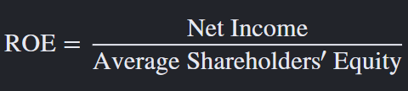
Definitions
Net income is a business’s profit after subtracting expenses, taxes, interest, and depreciation from revenue or gross income.
Net cash is a liquidity metric representing a company's total cash and cash equivalents minus its total debt or current liabilities.
Free cash flow (FCF) is the cash a company generates after covering its operating expenses and capital expenditures (CapEx), representing the money available to pay dividends, reduce debt, or reinvest for growth.

